Slide 1
SURF 2024 – 9th Meeting
Ryan Hsieh 2024/07/17

Slide 2
AGENDA
Data Mapping: Substations vs EPA Power Plants Data
"optimize!(...)" command in Breakthrough Energy's Julia code
Scenario create for renewable source

Slide 3
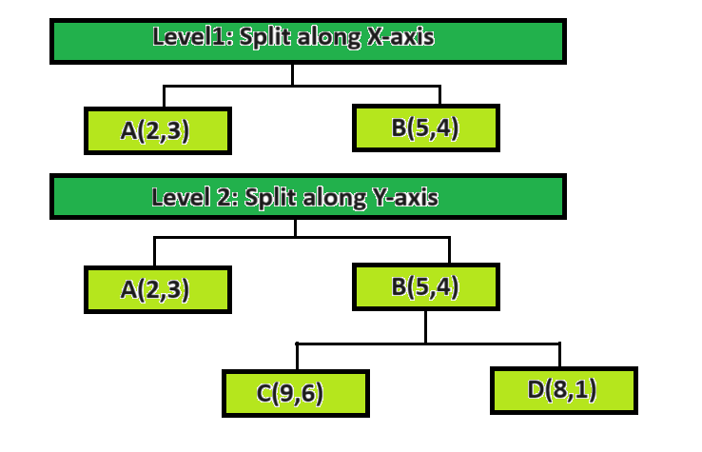
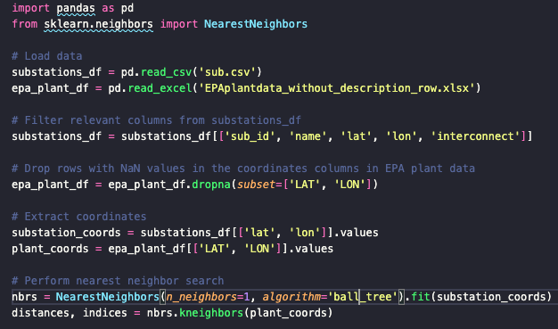
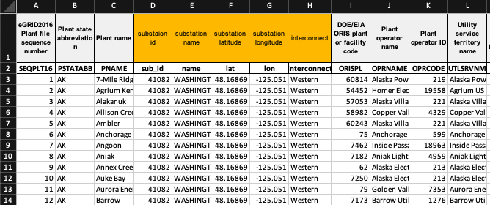
Substation mapped w/ Plants
Use of ball tree algorithm which is related to KDtree
Partitioning ==> Organizing & Searching multidimensional data
Specifically help to find nearest neighbors
Split & Sort in two directions : x & y
Now:
Able to map back to BE substation data with the sub_id
Can categorized more detail for Power Plants using specific energy type (Coal)

Slide 4
"optimize!(...)" command in Breakthrough Energy's Julia code
Location of optimization called & Created sample script & Runtime

Slide 5
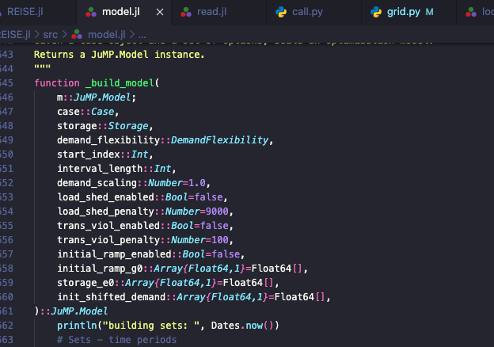
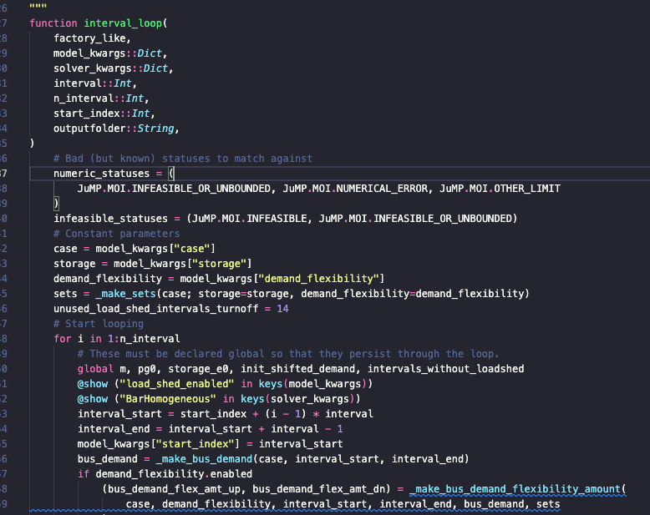
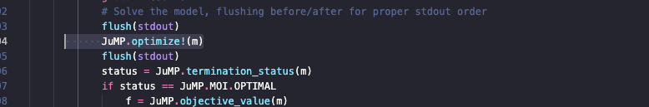
Optimization calculation command in julia function
Last time : Figured out where they build the Optimization Model for OPF ==> REISE.jl/src/model.jl
Now: Figured calling the optimization calculation using this model in ==> REISE.jl/src/loop.jl

Slide 6
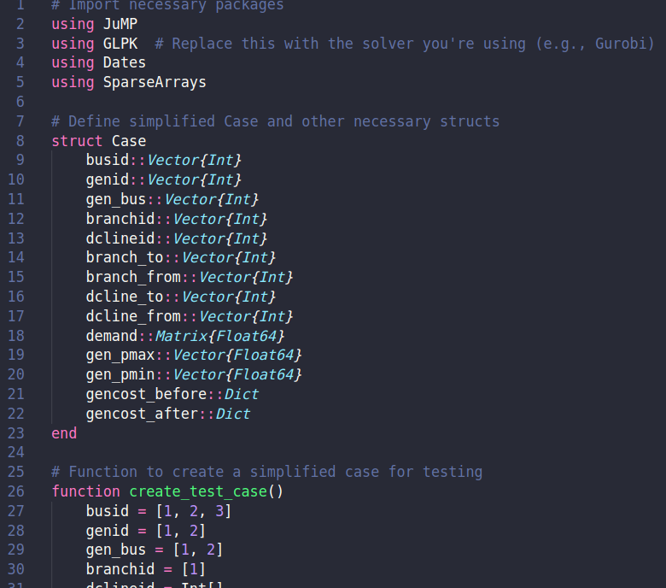
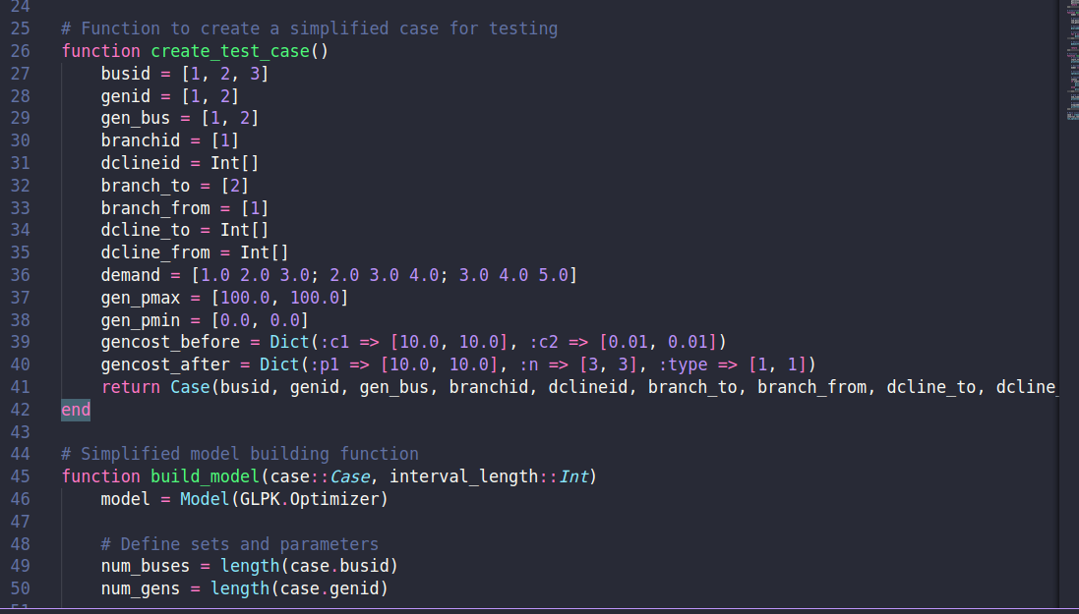
Sample use of optimization calculation

Slide 7
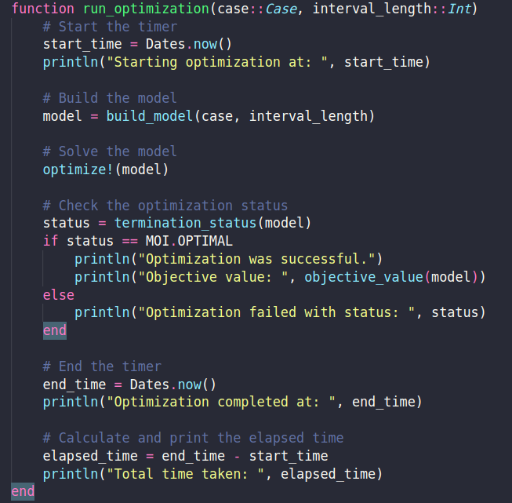
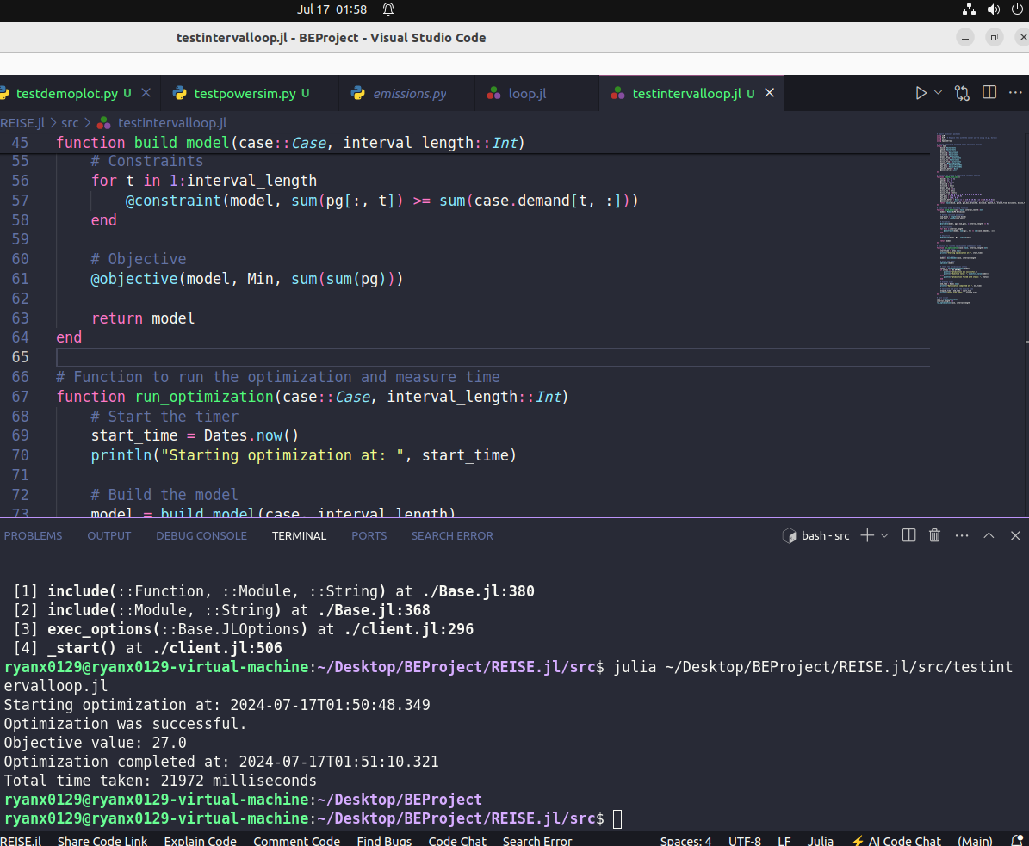
Sample use of optimization calculation

Slide 8
Scenario create for renewable src
Algorithms

Slide 9
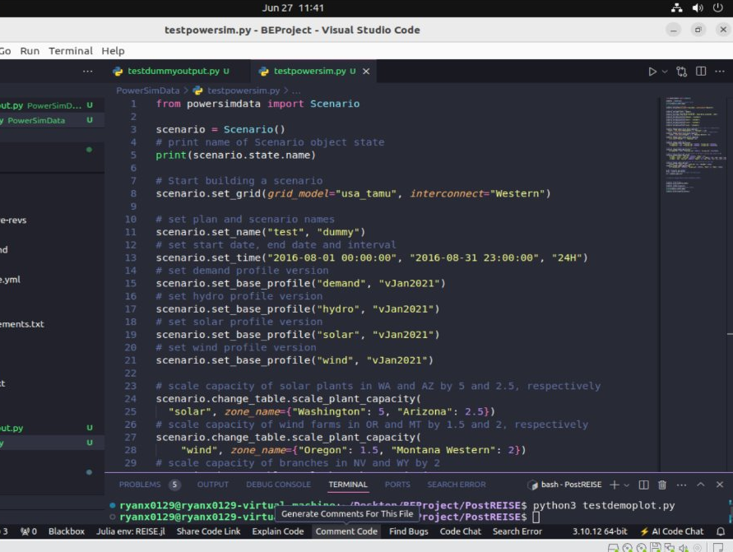
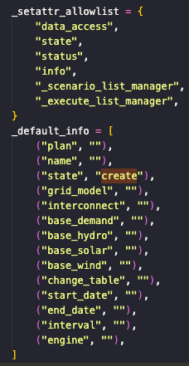
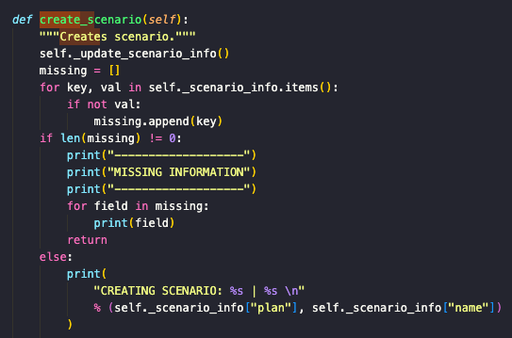
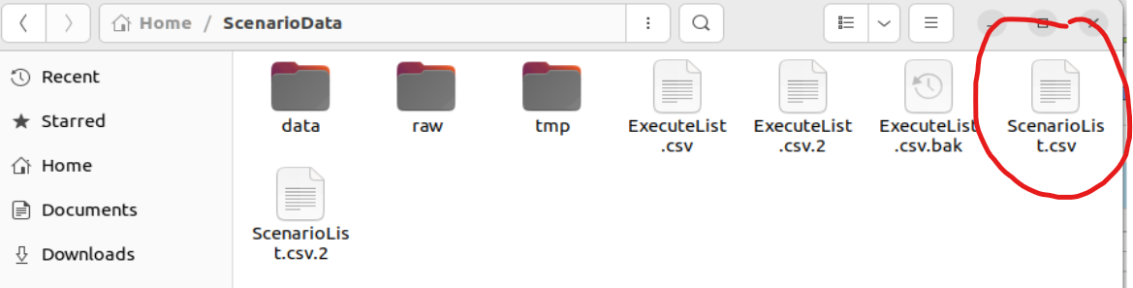
Creating scenario flow
Call scenario: ==> scenario = Scenario(scenario id or name)
If scenario id or name not found (I created a case named dummy):
Generate to locate in Generated Scenario will appear in ScenarioList.csv
Start building a scenario: ==> scenario.set_grid(grid_model="usa_tamu", interconnect="Eastern")
Grid model remain the same using "usa_tamu" = includes all the based data need (branch, bus, bus2sub, dcline, … etc.)
Interconnect based on what to analyze --> Choose Eastern for our case
Set time interval for data analysis & energy profile version (given in based data file)
[optional] Modify Grid to add or scale renewable plants or other grid components
Validate and Create the Scenario
Running the Scenario and Extracting Output Data

